Slide 1
Digits Recognition With CNN
Final Project
APAN 5335 Machine Learning
Summer 2022
Shay Chen (mc4564)

Slide 2
Contents
This slide is structured as follows:
1 - Project Goal | To give a overview of project
2 - Data Schema | To introduce the setup of datasets and images used
3 - Data Processing | Describe methods used for data processing
4 - Model Design | Explain the design of the convolutional neural network
5 - Model Evaluations | Show the evaluations of models
6 - Related Questions | Answer related questions about the project

Slide 3
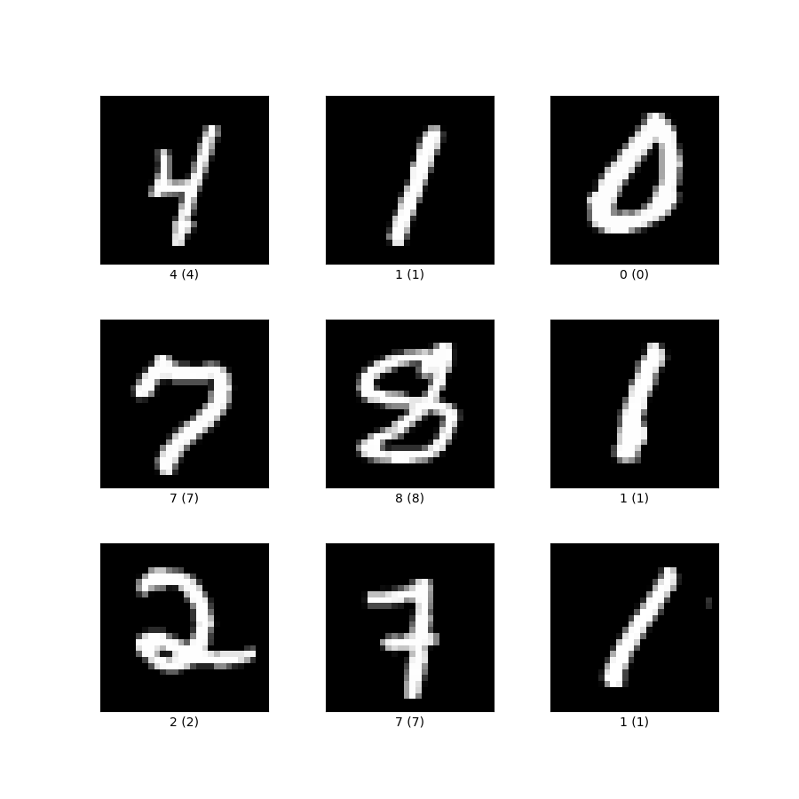
Project Goal
The goal of the project is to use MNIST dataset as training and implement a Convolutional Neural Network to predict the labels of the class's aggregated handwritten digit dataset.
MNIST DATASET
Notes:
Hope to achieve a high accuracy using CNN
Since the previous assignment, there are no high accuracy.

Slide 4
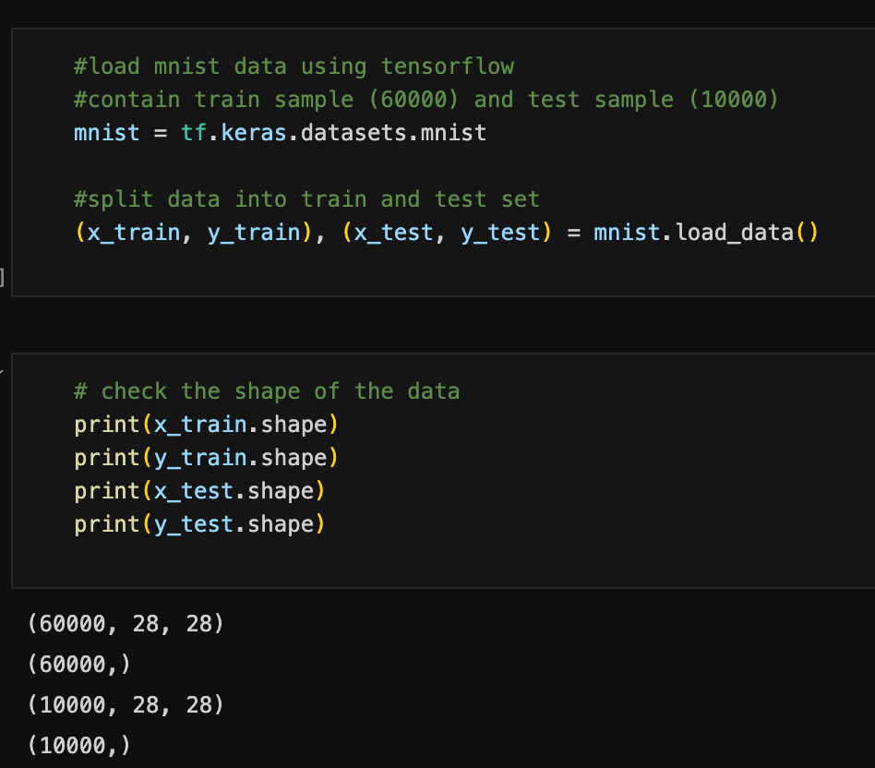
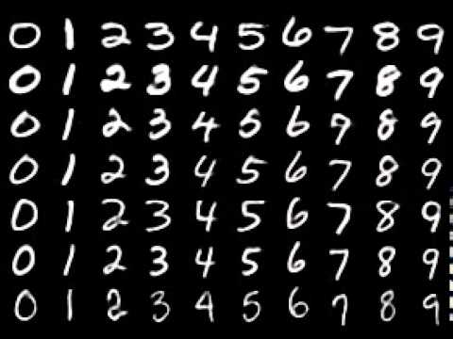
Data Schema - 1
Original Class Collected Handwritten Digits
MNIST Data Shape
Notes:
In previous assignments, we wrote 10 digits from 0 to 1

Slide 5
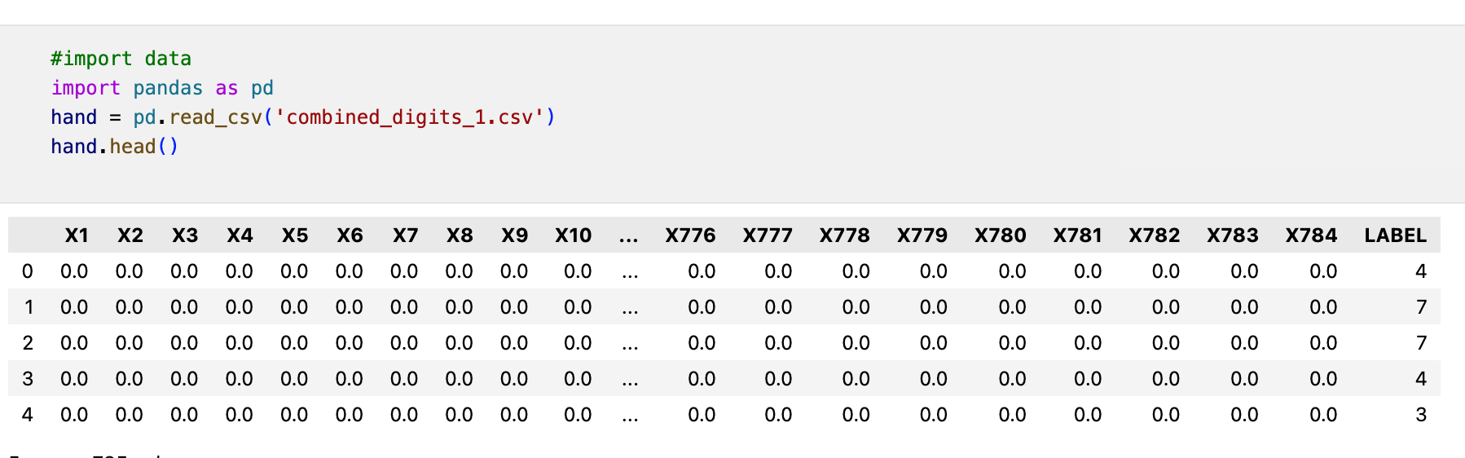
Data Schema - 2
Class Collected Handwritten Digits
(CSV Version)
4252 * 785
Notes:
In previous assignments, we wrote 10 digits from 0 to 1

Slide 6
Data Processing
Procedures:
Separate label column
Convert 1:784 to matrix
Set Dimension to (4252, 28, 28)

Slide 7
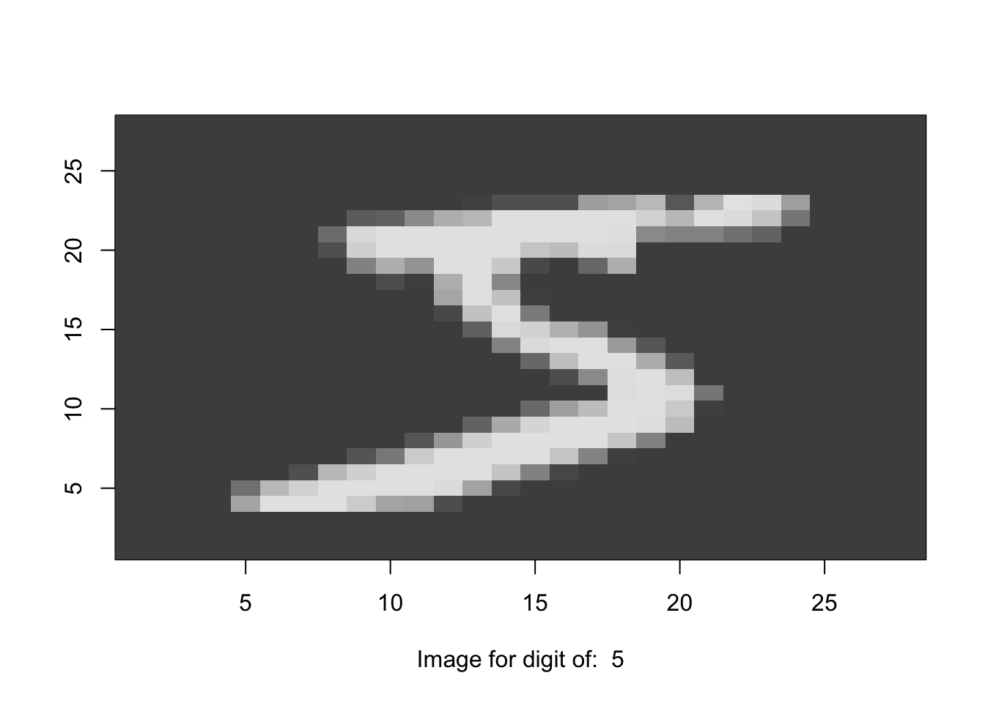
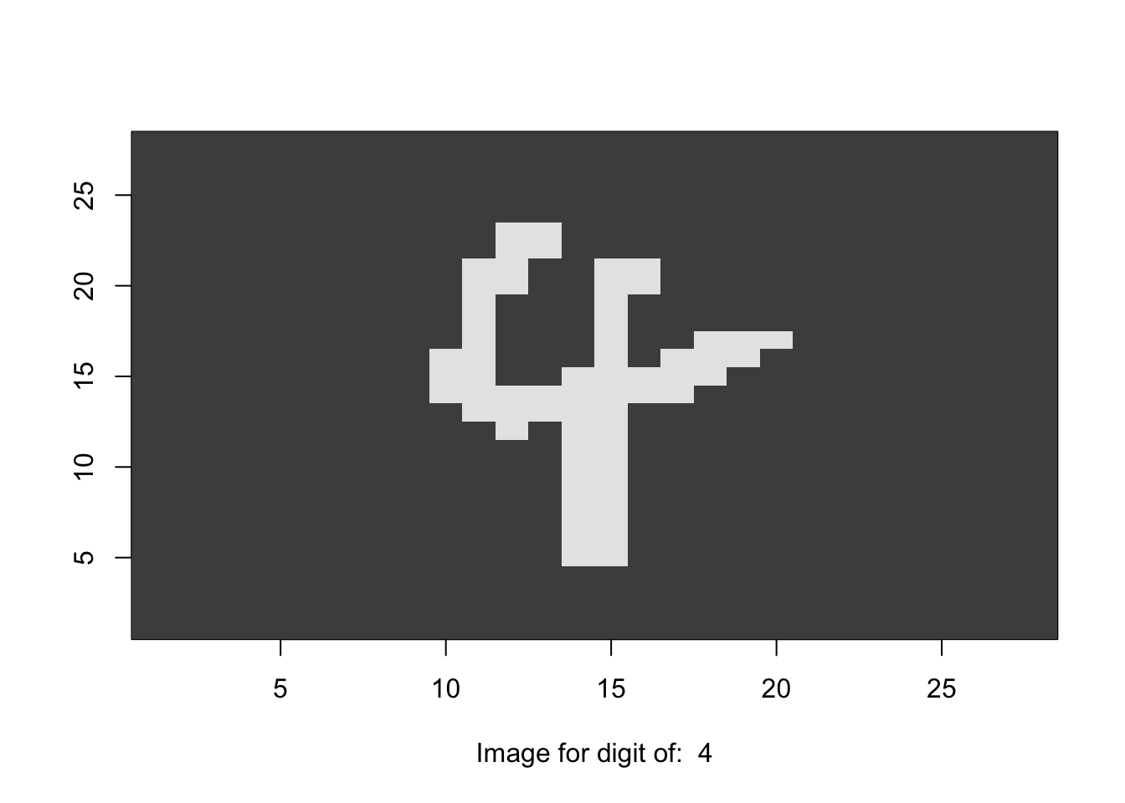
Data Processing
Image of a handwritten data after processing to matrix
Image of MNIST Digit
Notes:
In previous assignments, we wrote 10 digits from 0 to 1

Slide 8
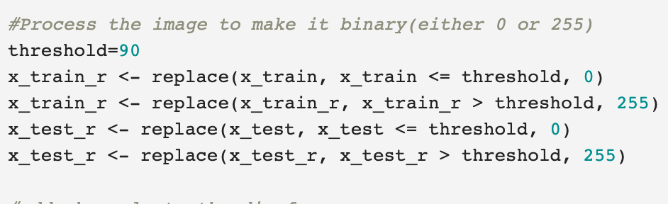
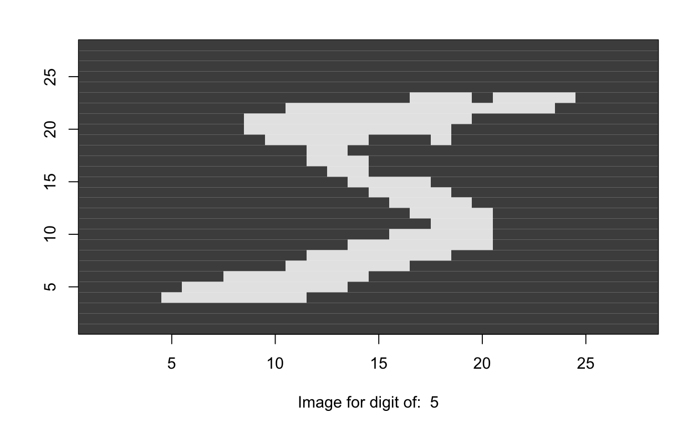
Data Processing
Process the value of MNIST Training Dataset
Notes:
In previous assignments, we wrote 10 digits from 0 to 1

Slide 9
Data Processing
Procedures:
Add Channels to the dimension (4252, 28, 28 , 1)
Normalization
Convert y to categorical variable

Slide 10
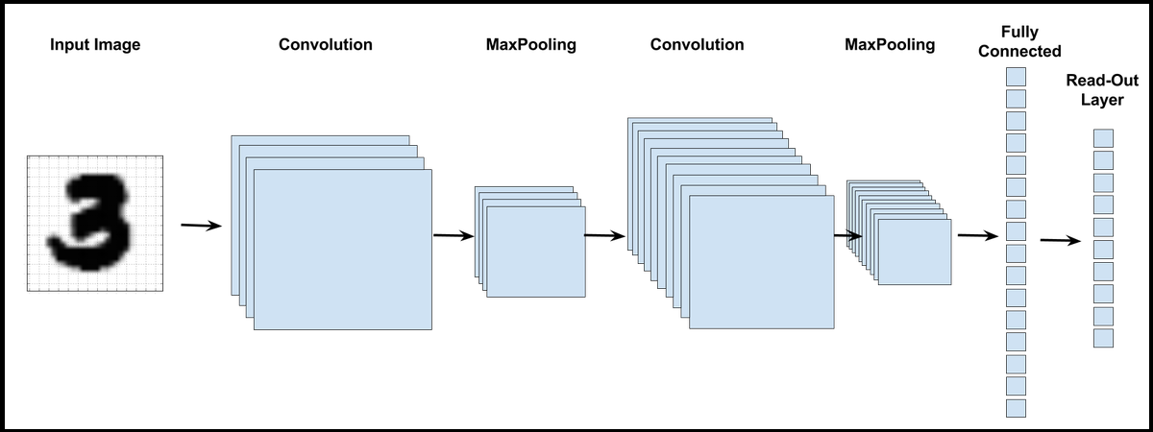
CNN Model Design 1
Input(28x28x1)
Filter 32
Kernel Size (3x3)
26x26x32
Max Pooling (2x2)
13x13x32
Filter 48
Kernel Size (3x3)
11x11x48
Max Pooling (2x2)
5x5x48
Fully Connected
(600)
Fully Connected
(10)

Slide 11
Model1 Details
ReLU
Epochs & Batch Size
DROPOUT
SOFTMAX
Used in every conv layer
epochs = 12
Batch size = 256
Rate = 0.27
In last layer for multi-classification

Slide 12
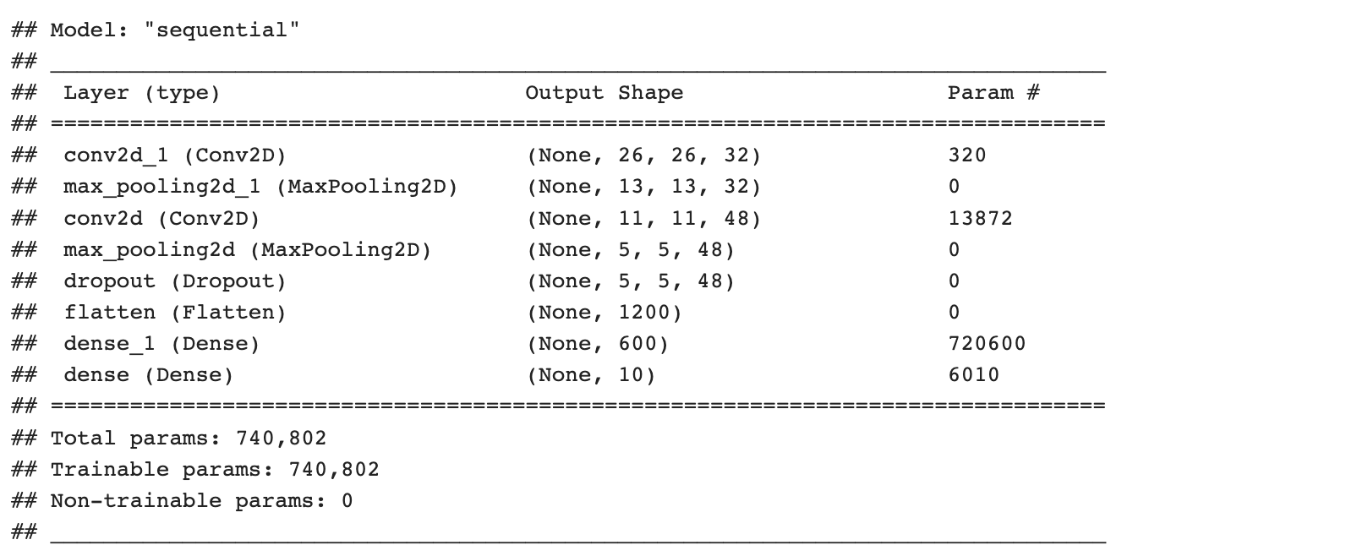
Model1 Summary

Slide 13
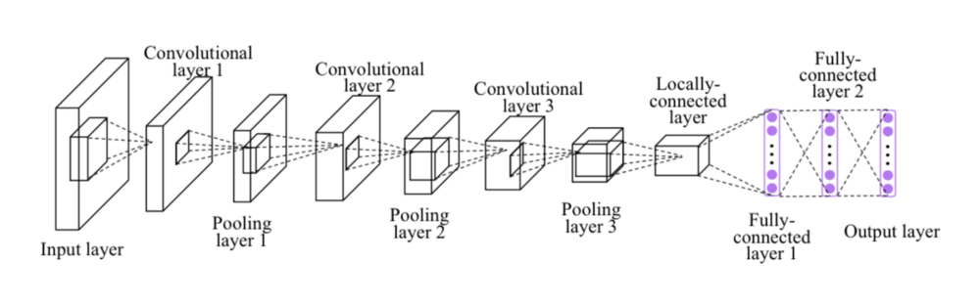
CNN Model Design 2
Input(28x28x1)
Max Pooling (3x3)
13x13x32
Max Pooling (3x3)
13x13x32
Max Pooling (3x3)
13x13x32
Layer Flatten
Fully Connected
(32)
Fully Connected
(10)
Filter 32
Kernel (4x4)
26x26x32
Filter 32
Kernel (4x4)
26x26x32
Filter 32
Kernel (4x4)
26x26x32

Slide 14
Model2 Details
ReLU
Epochs & Batch Size
Padding
SOFTMAX
Used in every conv layer
epochs = 10
Batch size = 256
same
In last layer for multi-classification

Slide 15
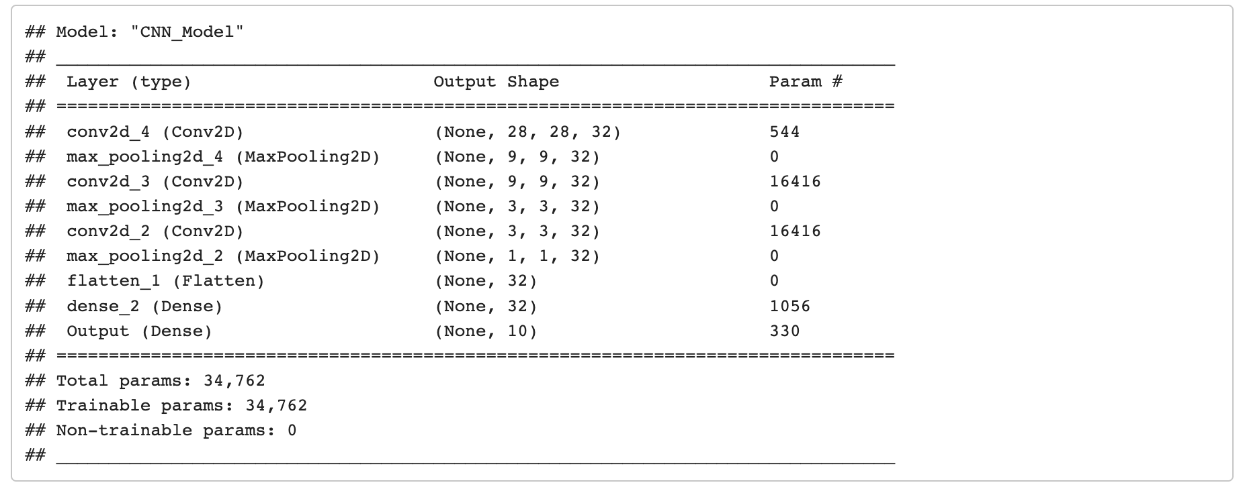
Model2 Summary

Slide 16
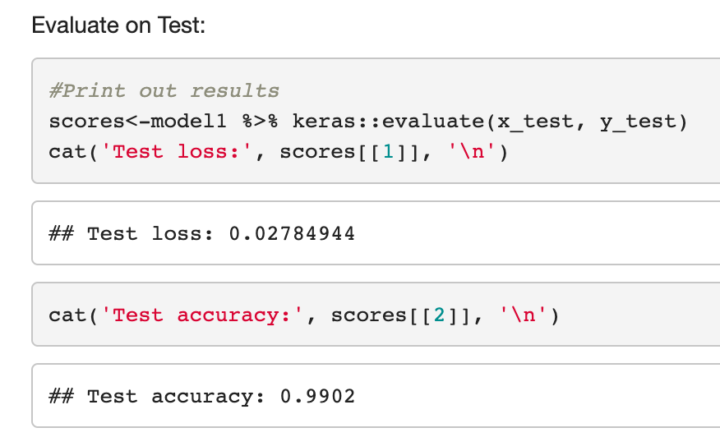
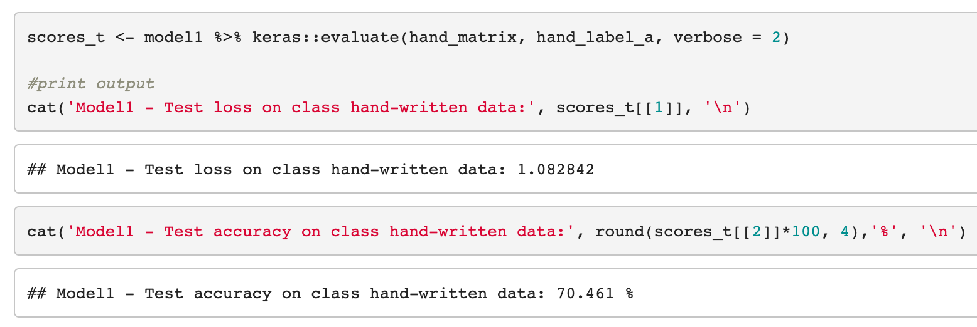
Model1 Evaluations
MNIST: 99.02%
Handwritten: 70.461%

Slide 17
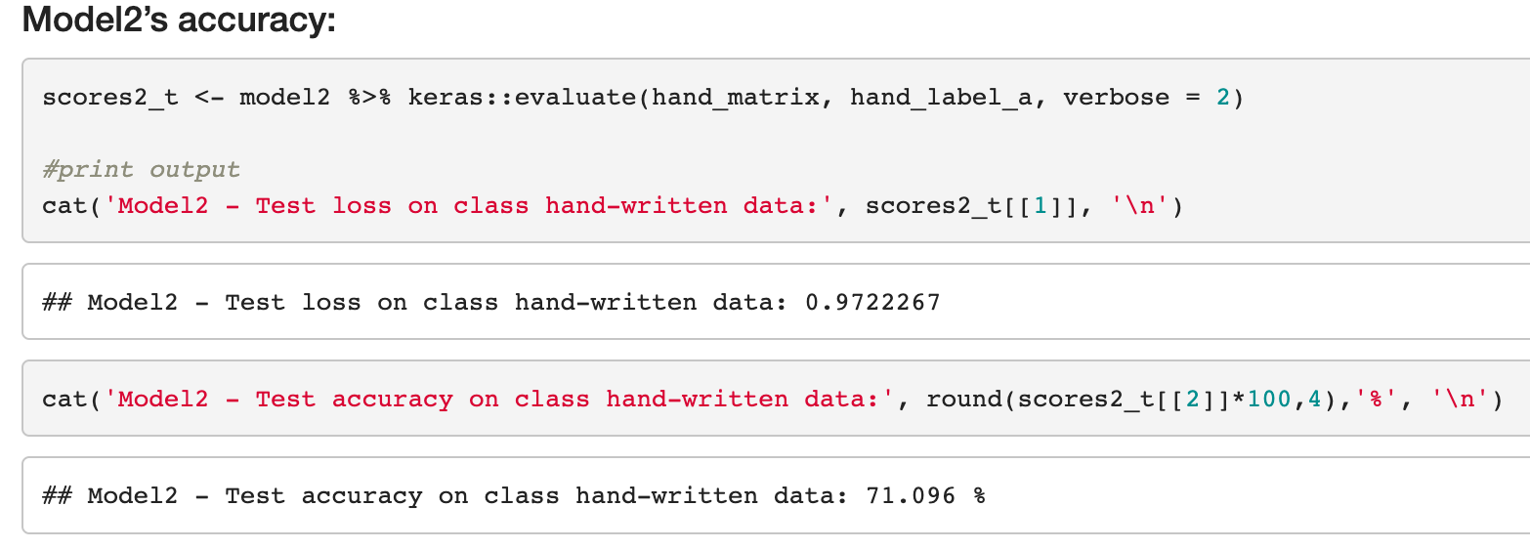
Model2 Evaluations
MNIST: 98.7%
Handwritten: 71.096%

Slide 18
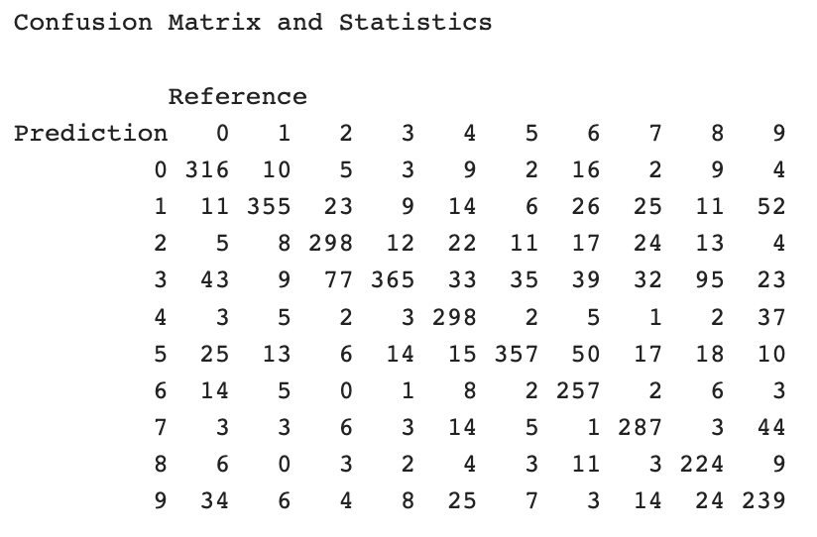
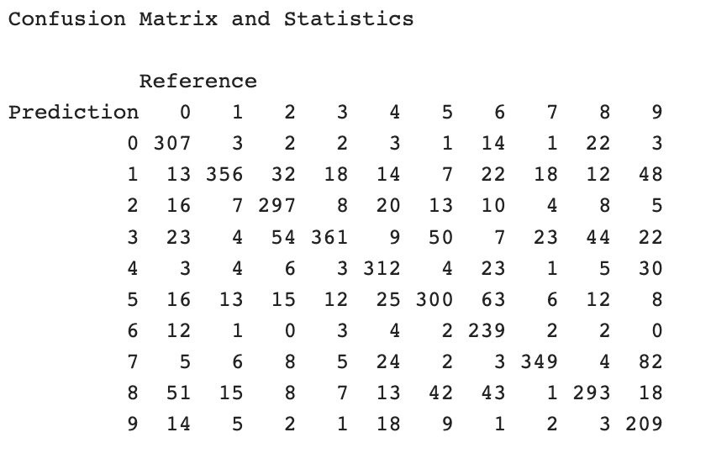
Evaluations: Confusion Matrix
Model1
Model2

Slide 19
Related Questions:
What is Max Pooling? How else might Pooling be performed? What does pooling do to an image? What does the stride length represent?
extract low level features and to down-sample an input
decreases the dimensionality of images
How does convolution work? What do the terms filter and kernel size represent?
By using filters/kernel to extract features

Slide 20
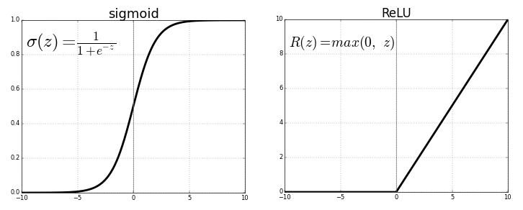
Related Questions:
Briefly explain the choices you made in architecting your network in part 1. What types of layers, and how many of each did you use and why?
What is an activation layer and why are activation layers necessary? Briefly explain how ReLU activation and Sigmoid activation differ.

Slide 21
Related Questions:
Why might a neural network with convolution and/or other elements be a more accurate predictor for labeling image data than a classical algorithm, such as multi-class Logistic Regression, an SVM or a Decision Tree?

Slide 22
Thank you!

